Slide 1

Overview of the
Patent Cooperation Treaty (PCT)

Slide 2
What is the PCT?
An international treaty facilitating the process of seeking patents internationally
An efficient and advantageous procedure for users of the patent system and patent Offices
Signed in June 1970 and became operational in June 1978 with 18 Contracting States

Slide 3
General Remarks on the PCT
The PCT system is a patent “filing” system, not a patent “granting” system
The PCT system consists of an international and national phase
The decision on granting patents is taken exclusively by national or regional Offices in the national phase

Slide 4
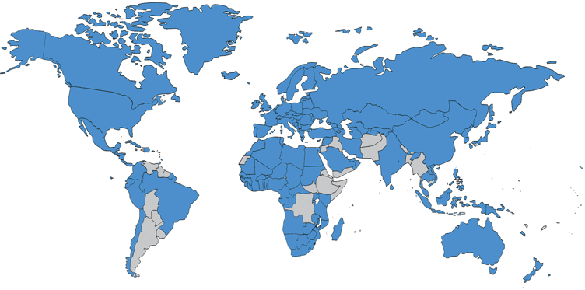
148 PCT Contracting States

Slide 5
Countries not yet PCT Contracting States
Afghanistan Andorra Argentina Bahamas Bangladesh Bhutan Bolivia Burundi Cambodia Cape Verde Democratic Republic of Congo Djibouti Eritrea Ethiopia Fiji Guyana | Haiti Iraq Jamaica Jordan Kiribati Kuwait Lebanon Maldives Marshall Islands Mauritius Micronesia Myanmar Nauru Nepal Pakistan Palau | Paraguay Samoa Solomon Islands Somalia South Sudan Suriname Timor-Leste Tonga Tuvalu Uruguay Vanuatu Venezuela Yemen (45) UN: 193 countries

Slide 6
PCT Applications (2014)
~214,500 applications
4.5 % increase over 2013

Slide 7
Filings by Country of Origin (2014)
Examples of increases in certain national Offices
CN: +18.7 % UK: +9 % US: +7.1 %

Slide 8
Fields of Technology (2014)

Slide 9
Top PCT Applicants (2014)
1. Huawei (CN) – 3442 | 11. Samsung (KR) – 1381
2. Qualcomm (US) – 2409 | 12. Toyota (JP) – 1378
3. ZTE (CN) – 2179 | 13. Bosch (DE) – 1371
4. Panasonic (JP) – 1682 | 14. Sharp (JP) – 1227
5. Mitsubishi Electric (JP) – 1593 | 15. NEC (JP) – 1215
6. Intel (US) – 1539 | 16. LG Electronics (KR) – 1138
7. Ericsson (SE) – 1512 | 17. Tencent Technology (CN) – 1086
8. Microsoft (US) –1460 | 18. Fujifilm (JP) – 1072
9. Siemens (DE) – 1399 | 19. United Technologies (US) – 1013
10. Philips (NL) –1391 | 20. Hitachi (JP) – 996

Slide 10
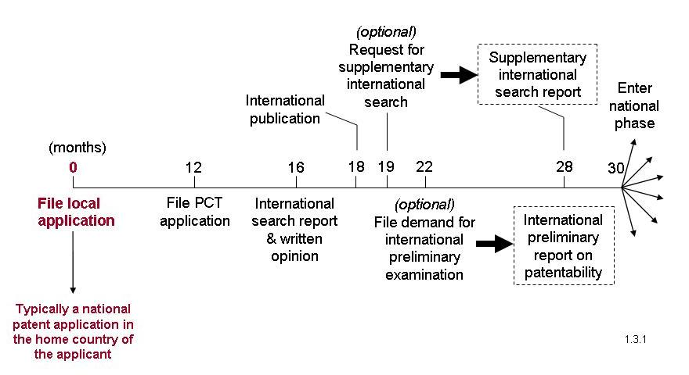
Typical PCT Timeline

Slide 11
The PCT system – typical use
Enter
national
phase
International
publication
Suplementary
International
Search (optional)
(months)
0
12
16
18
19
22
28
30
File local
application
File PCT
application
International
search report & written opinion
(optional)
File demand for international
preliminary
examination
(optional)
International
preliminary report on patentability
Typically a national patent application in the home country of the applicant
Notes:
11

Slide 12
Typical use (2)
Enter
national
phase
International
publication
Suplementary
International
Search (optional)
(months)
0
12
16
18
19
22
28
30
File local
application
File PCT
application
International
search report & written opinion
(optional)
File demand for international
preliminary
examination
(optional)
International
preliminary report on patentability
Typically also filed with local Patent Office. One set of fees, one language, one set of formality requirements. Legal effect in all PCT States.
Notes:
12

Slide 13
Typical use (3)
Enter
national
phase
International
publication
Suplementary
International
Search (optional)
(months)
0
12
16
18
19
22
28
30
File local
application
File PCT
application
International
search report & written opinion
(optional)
File demand for international
preliminary
examination
(optional)
International
preliminary report on patentability
Report on state of the art (prior art documents and their relevance) + initial opinion on patentability
Notes:
13

Slide 14
Typical use (4)
Public disclosure to the world of content of application in standardized way
International
publication
Suplementary
International
Search (optional)
Enter
national
phase
(months)
0
12
16
18
19
22
28
30
File local
application
File PCT
application
International
search report & written opinion
(optional)
File demand for international
preliminary
examination
(optional)
International
preliminary report on patentability
Notes:
14

Slide 15
Typical use (5)
Suplementary
International
Search (optional)
Enter
national
phase
International
publication
(months)
0
12
16
18
19
22
28
30
File local
application
File PCT
application
International
search report & written opinion
(optional)
File demand for international
preliminary
examination
(optional)
International
preliminary report on patentability
Request an additional patentability analysis on basis of amended application
Notes:
15

Slide 16
Typical use (6)
Suplementary
International
Search (optional)
Enter
national
phase
International
publication
(months)
0
12
16
18
19
22
28
30
File local
application
File PCT
application
International
search report & written opinion
(optional)
File demand for international
preliminary
examination
(optional)
International
preliminary report on patentability
Additional patentability analysis, designed to assist in national phase decision-making
Notes:
16

Slide 17
Typical use (7)
Express intention and take steps to pursue to grant in various States
International
publication
Enter
national
phase
Suplementary
International
Search (optional)
(months)
0
12
16
18
19
22
28
30
File local
application
File PCT
application
International
search report & written opinion
(optional)
File demand for international
preliminary
examination
(optional)
International
preliminary report on patentability
Notes:
17

Slide 18
PCT International Phase
Unified filing procedure consisting of the filing and processing of a single application with legal effect in all PCT Contracting States
Information on the potential patentability of an invention prior to the start of national patent procedures (“national phase”)
Publication of the international application together with the International Search Report
Time delay of at least 30 months before the start of the national patent procedure

Slide 19
What Does a PCT Application Contain?
A request
A description
One or more claims
Drawings (where necessary)
An abstract

Slide 20
The Receiving Office
PCT applications are filed with a receiving Office
Formalities check of the PCT application
Accords or refuses an international filing date
Specifies one or more International Authorities for search or examination
Collects fees for the receiving Office, International Bureau and the International Searching Authority

Slide 21
International Search
Performed by an International Searching Authority
PCT Minimum Documentation (PCT Rule 34)
Everything which has been made available to the public, anywhere in the world, by means of written disclosure
Capable of being of assistance in determining that the claimed invention is or is not new and that it does or does not involve an inventive step
Made available to the public prior to the international filing date

Slide 22
International Searching Authorities
Australia
Austria
Brazil
Canada
Chile
China
Egypt
Finland
India
Israel
Japan
Republic of Korea
Russian Federation
Singapore
Spain
Sweden
Ukraine (not yet operating)
United States of America
European Patent Office
Nordic Patent Institute (Denmark, Iceland, Norway)
Visegrad Patent Institute (not yet operating) (Czech Republic, Hungary, Poland, Slovakia)

Slide 23
International Search Report (ISR)
IPC (International Patent Classification) symbols
Indications of the technical areas searched
Indications relating to any finding of lack of unity
A list of the relevant prior art documents
Indications relating to any finding that a meaningful search could not be carried out in respect of certain (but not all) claims

Slide 24
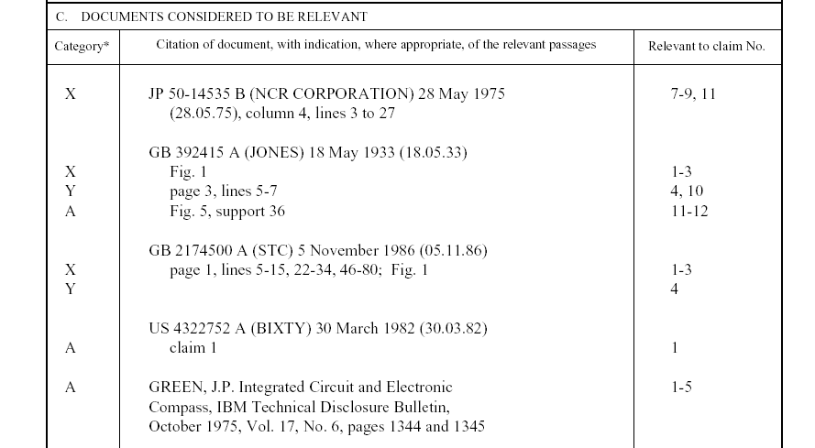
Example of an ISR
Symbols indicating which aspect of patentability the document cited is relevant to (for example, novelty, inventive step, etc.)
Documents relevant to whether or not your invention may be patentable
The claim numbers in your application to which the document is relevant

Slide 25
Written Opinion of the ISA
A preliminary non-binding opinion on novelty, inventive step and industrial applicability
Established at the same time as the ISR
Made available to the public on the WIPO web site at the same time as the ISR
No formal response procedure although applicants may submit informal comments

Slide 26
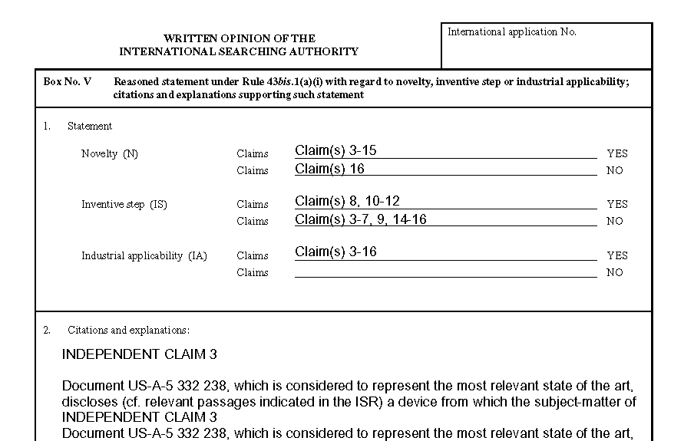
Example of the Written Opinion
Patentability assessment of the claims
Reasoning supporting the assessment

Slide 27
International Publication (1)
Takes place shortly after 18 months from the earliest filing date
One of the main functions of the International Bureau
Contents of published PCT application
Standardized front page with bibliographic data, title and abstract
Description, claims and drawings (if any)
International Search Report
Other elements prescribed by the PCT Regulations (e.g., amended claims, declarations, etc.)

Slide 28
International Publication (2)
Ten publication languages (Arabic, Chinese, English, French, German, Japanese, Korean, Portuguese, Russian, Spanish)
PCT application file maintained by the International Bureau is publicly available after international publication and contains other documents such as the application as filed, written opinion of the ISA, PCT Forms and general correspondence

Slide 29
Supplementary International Search
Introduced on January 1, 2009
Optional procedure
More comprehensive overview of the prior art, e.g., language coverage
Offered by Austria, European Patent Office, Finland, Russian Federation, Singapore, Sweden, Nordic Patent Institute (7)

Slide 30
International Preliminary Examination
Optional procedure
Requested by filing a demand with an International Preliminary Authority (IPEA) (same list as ISA)
Opportunity to amend the description, claims and drawings to address objections raised by the ISA before the national phase procedure
Results in the issuance of a preliminary, non-binding opinion by the IPEA on novelty, inventive step and industrial applicability
International Preliminary Report on Patentability (Chapter II) – IPRP Ch.II

Slide 31
PCT National Phase
After the end of the international phase (30 months)
PCT is a gateway to national patent systems
Leads to the grant (or refusal) of a patent by national or regional Offices

Slide 32
Why Use the PCT?
“Internationalization” of a single PCT application providing near global geographical coverage
Time delay (additional time for decision making)
Cost deferral
Patentability assessment

Slide 33
Cost Deferral
Seeking patents in foreign countries requires a significant capital investment
The PCT provides for the deferral of main initial costs associated with internationalization:
Cost of translations
Local patent agent fees
Local patent Office fees

